Slide 1
about:other projects
Conference/event name
Location
name
openSUSE Ambassador
name@opensuse.org

Slide 2
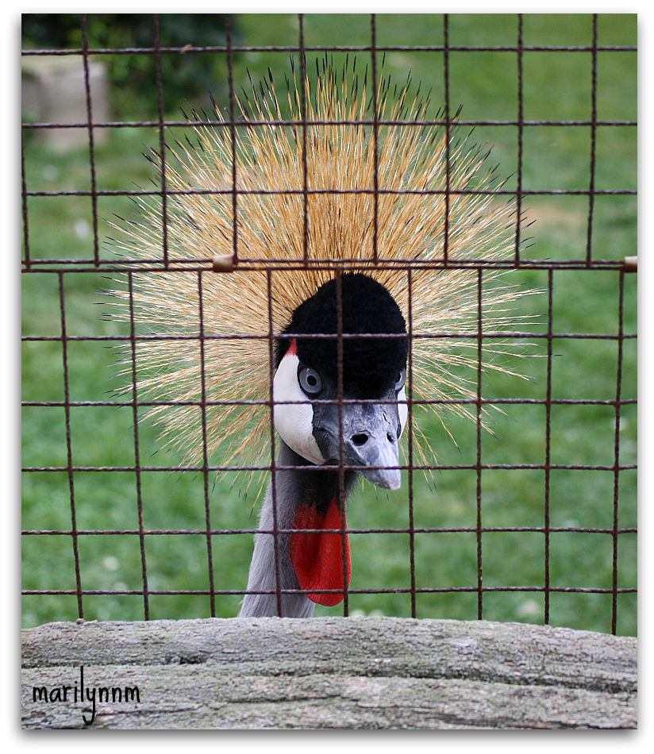
Me
Notes:
about yourself!

Slide 3
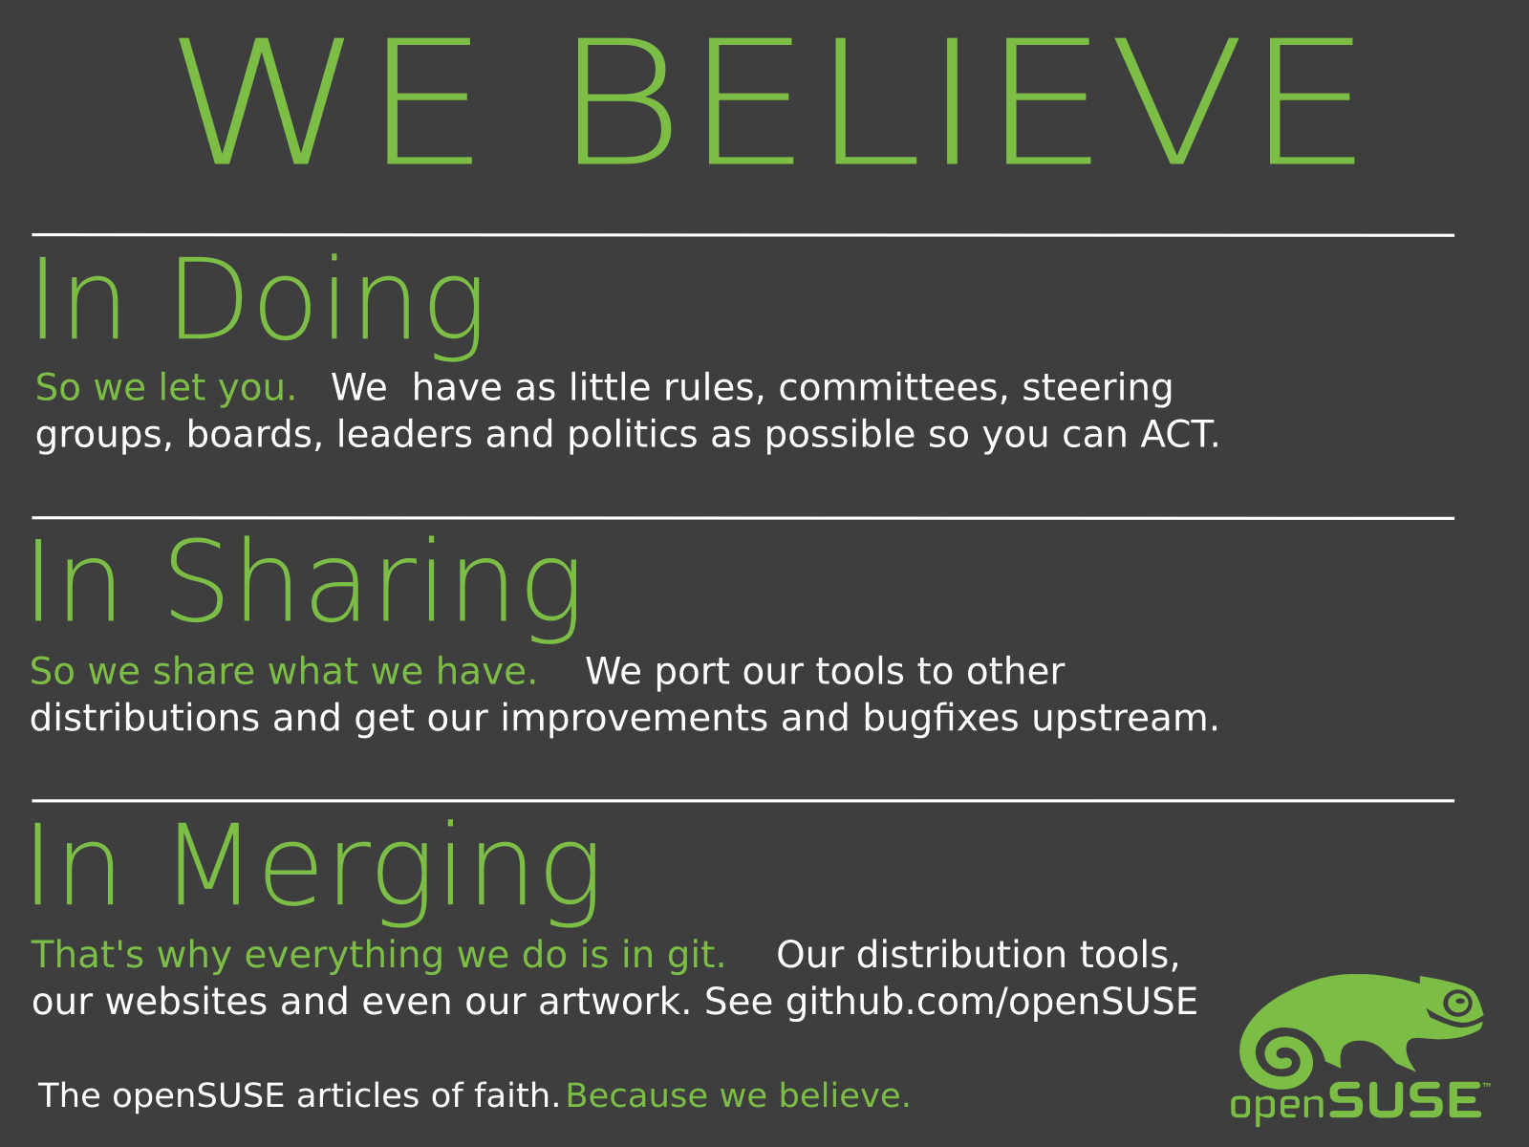
Notes:
To get to know openSUSE, you have to start with the people behind it.
We're an international crowd, and we believe that Free and Open is better than Closed. We believe that you get the most out of people by getting out of their way, by letting them share what they do and work with others across project and cultural boundaries!

Slide 4
the world's most flexible and powerful Linux distribution
Notes:
These people create a powerful and flexible Linux. We want to create something ready for real usage: easy but not limited, stable but not outdated. That's why we have a longer release cycle than most other distributions and have the best system management tools in the industry.

Slide 5
Tumbleweed
openQA
OpenSUSE ARM
Notes:
We will talk about 3 different openSUSE (based) projects besides the openSUSE distribution, SUSE Studio and the Open Build Service:
openSUSE Tumbleweed
OpenQA
openSUSE ARM

Slide 6

Tumbleweed
Notes:
The first openSUSE project: Tumbleweed
Tumbleweed is a project started by Kernel Hacker Greg Kroah-Hartman.
He is also contributing to Gentoo and as you might know, Gentoo is a Rolling distribution: there are no special releases. When something is done, it becomes available. And because it is Gentoo, you then Compile it :D

Slide 7
Rolling on
Always the latest stable software
  Latest kernel = latest hardware support
  Latest browser, office, desktop, games...
Smoothly 'rolling' to the next release of openSUSE
  No more 'download and install the new release'!
  No more adding special repositories for newer software
Slightly more risk of breakage (price of living on the edge!)
Notes:
openSUSE is of course not a compile-it-yourself distro, but with Tumbleweed, we offer a 'rolling' repository with the latest packages – after a short testing period.
We developed Tumbleweed because we noticed that many openSUSE users had a large number of extra repositories (often 20 or more!) with newer versions of their software. While OBS is quite good, this can get messy if you mix incompatible repositories. Tumbleweed is much better as it is one repository.

Slide 8
How?
Open Build Service
  Just submit...
opensuse.org/Tumbleweed
Notes:
Having both a stable release and a rolling one would be almost impossible without OBS.
Tumbleweed is just another repository on the Build Service. Package maintainers can easily get their packages in Tumbleweed via OBS.
For users, it is simple to. Just add the repository, disable the others and do a zypper dup.
Go to opensuse.org/Tumbleweed for fun!

Slide 9

openQA
Notes:
The next project I want to talk about is openQA

Slide 10

Fully automated testing
Covers:
  Installation and upgrade testing
  Daily regression testing
  Application testing
  benchmarking
Gives clear overview of test results along with screenshots and video
Notes:
openQA is a automated testing system which runs daily tests on the openSUSE development tree 'Factory'.

Slide 11
How?
Boot ISO in VM (KVM or Qemu)
Give pre-defined input (mouse, keyboard)
Take screenshots of process
Compare screenshots with reference
Show results in web interface
Notes:
It works by booting up a ISO image (which is automatically generated daily from the Open Build Service) in a Virtual Machine. It installs it, boots, starts some applications and does a few simple actions. It takes screenshots during that process. It will then compare the screenshots it got with what was expected and thus know the test results.

Slide 12
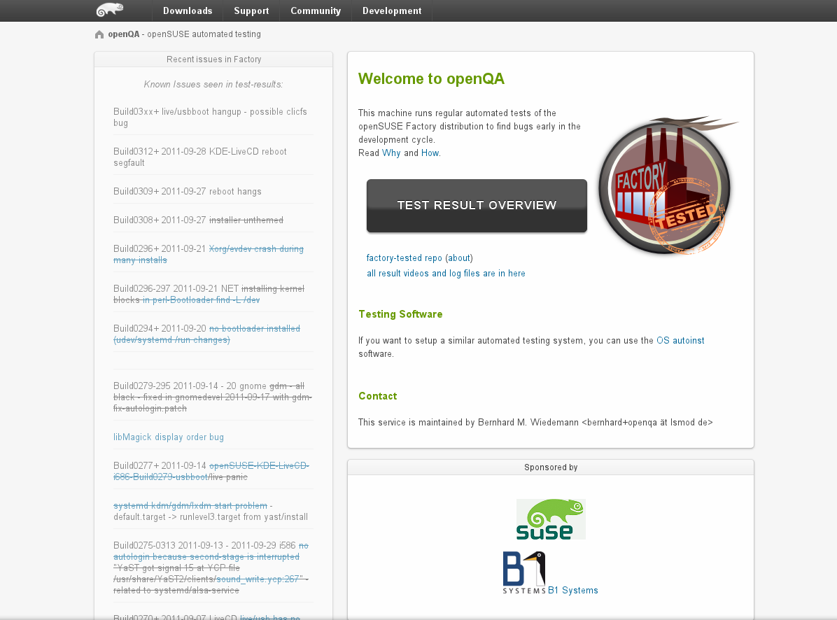
Notes:
This is the main interface of openqa.opensuse.org where you can check the test results.

Slide 13
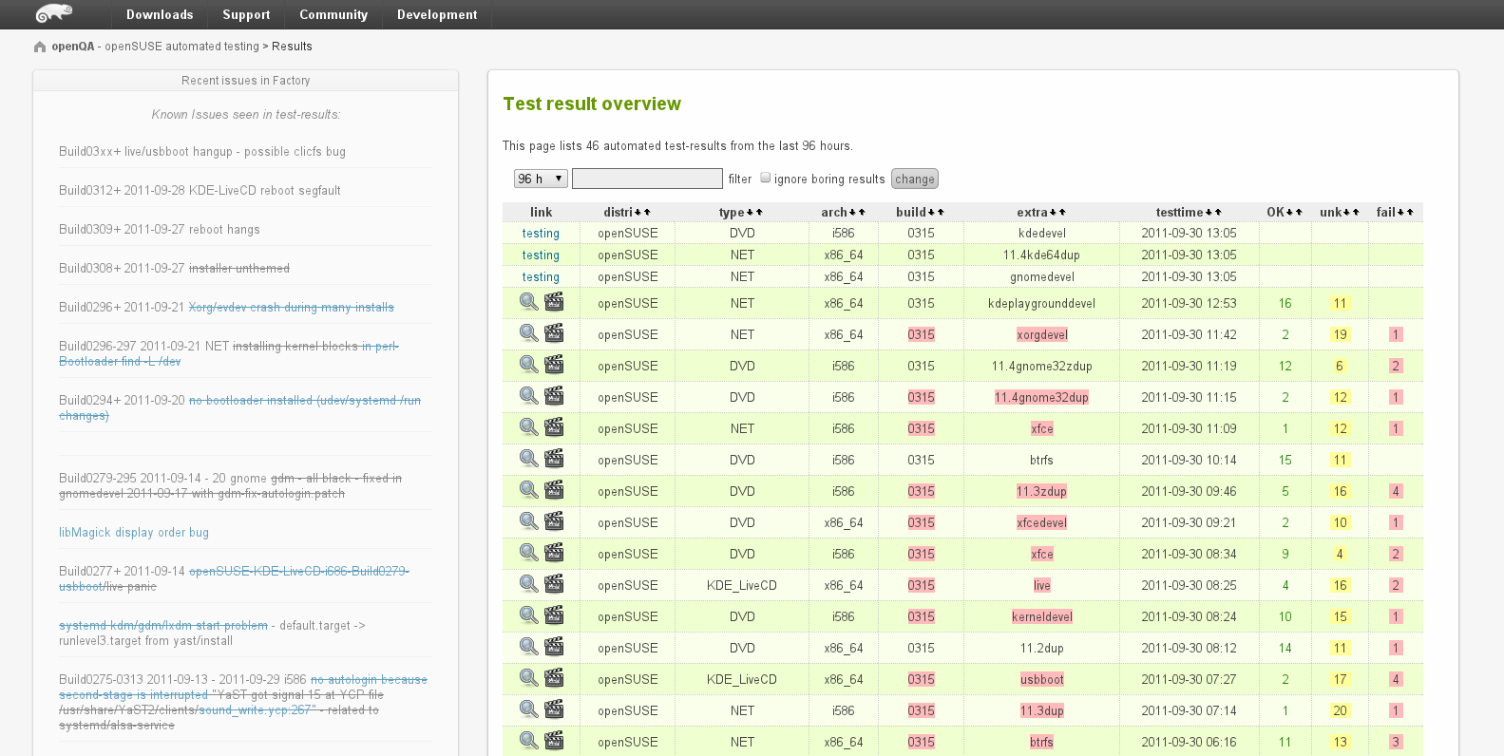
Notes:
Here is a list of tests which has run and the results.

Slide 14
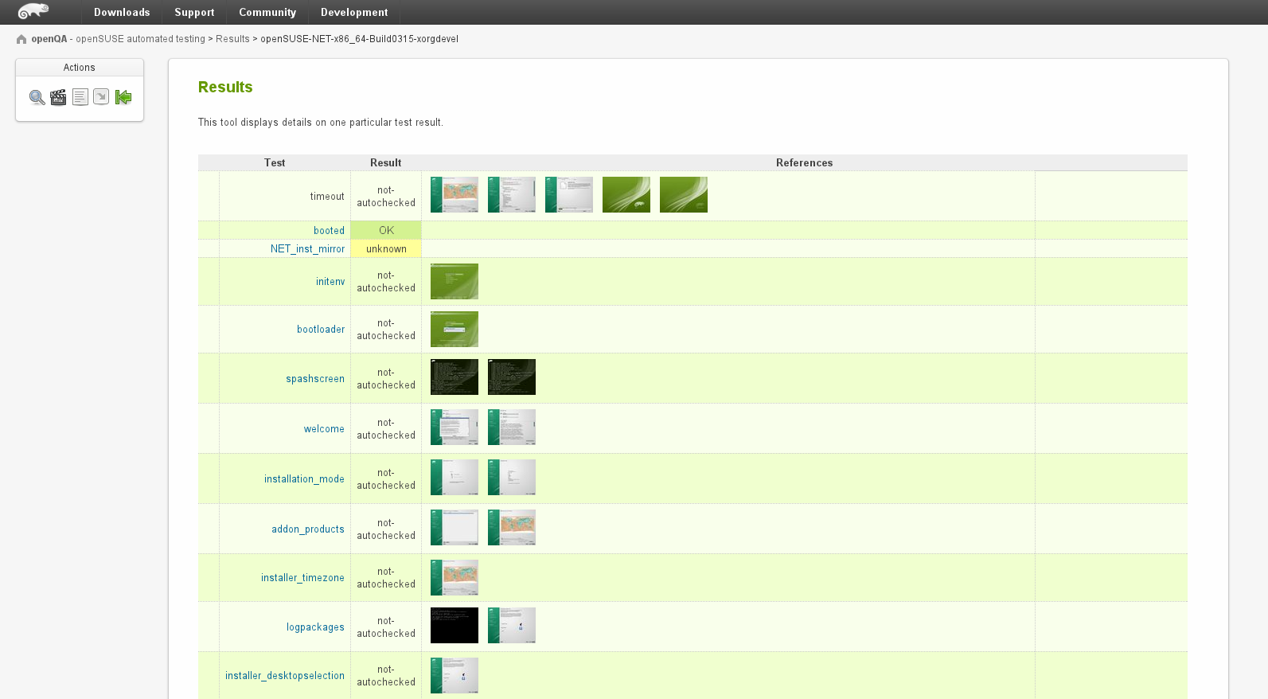
Notes:
You can see the details of a test, and as you can see you can download and inspect the screenshots.

Slide 15
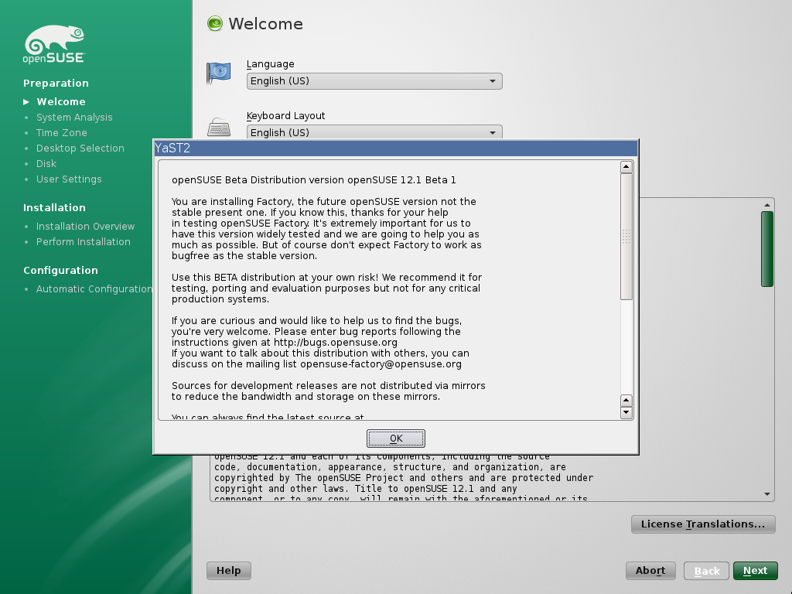
Notes:
Besides the screenshots openQA also offers video's of the whole process for download.

Slide 16

openSUSE ARM
Goal: get openSUSE building on ARM!
  Started by a few community members after oSC 2011
  Took off right away
    building most packages in a matter of weeks
Again showing power of OBS...
Now moving on to support more hardware
Notes:
openSUSE ARM is a real grass-roots project in the openSUSE community. It was started after the openSUSE Conference in October 2011.
As SUSE is pretty much entirely focused on big iron hardware like stock exchanges, they are not interested. Still SUSE supports us by providing infrastructure and admin support.

Slide 17
Status
Most of the openSUSE packages build and work
Boots and runs fine on beagle board!
Supported:
  armv5tel
  armv7l
Notes:
We currently focus on the most used ARM architectures: armv5tel (soft floating point with thumbs) and armv7l (hard floating point with aapcs-linux ABI)
Thanks to OBS it took us barely 2 weeks to get 2500 packages building and supporting other architectures should not be to hard. Get involved if you want openSUSE on your tablet or other ARM devices!

Slide 18

SuperKitty!
Notes:
By now everyone has to be convinced. openSUSE = super Kitty!
Awesome technology
Great plans

Slide 19

Newcomers welcome
Notes:
Which is always looking for new volunteers
people who actually want to make a difference!

Slide 21

Join the gang
Notes:
... come join us and have fun...
Try openSUSE, Tumbleweed, SUSE Studio, TRY OBS, play with us!

Slide 22

Be a Geeko/Kitten
Notes:
Be the Geeko you can be!

Slide 23
Image credits
Me: MarilynM
Tumbleweed: somenametoforget
SuperKitty: malingering
Newcomers: abcrumly
Join the gang: malingering
GeekoKitten: no idea
To be found on Flickr under the above names with a Creative Commons license. Thanks all!

Slide 24
Your next Linux Distribution!

